Slide 1
Microsoft Build

Slide 2
Windows
Mike Irving

Slide 3
Windows
Dev Home
Including Dev Drive
Windows Subsystem for Android™️
Opportunities for developers
Amazon Appstore
Debugging Android Apps

Slide 4
Dev Home

Slide 5
Dev Home
New App – Dev Home (Preview)
Available in the Microsoft Store
What is it?
An app to setup and monitor projects:
downloading apps, packages, or repositories
connect to your developer accounts and tools (such as GitHub)
Configure / use a Dev Drive for storage
Dashboards and Widgets
monitor workflows, track your dev projects, coding tasks
GitHub issues, pull requests
SSH connections
System CPU, GPU, Memory, and Network performance
Machine configuration
Set up your development environment on a new device or onboard a new dev project
Dev Drive

Slide 6
Dev Home
Download from the Microsoft Store - https://aka.ms/devhome

Slide 7
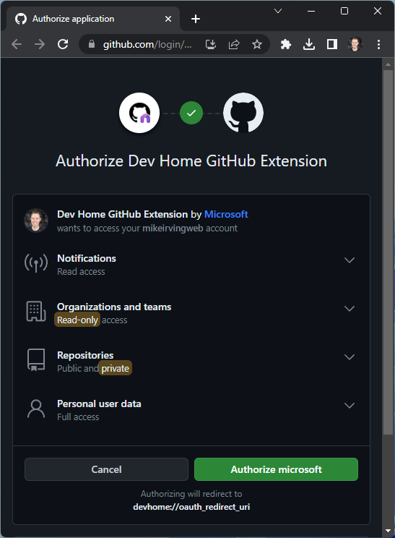
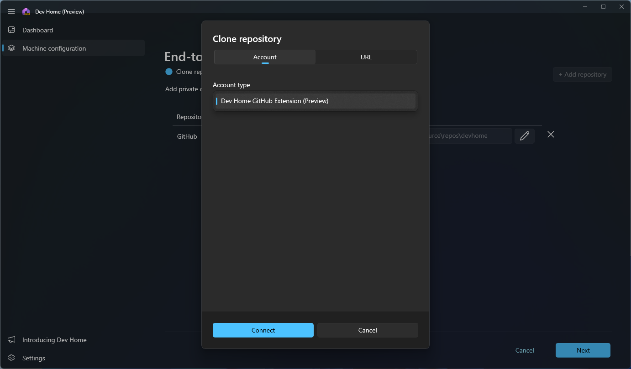
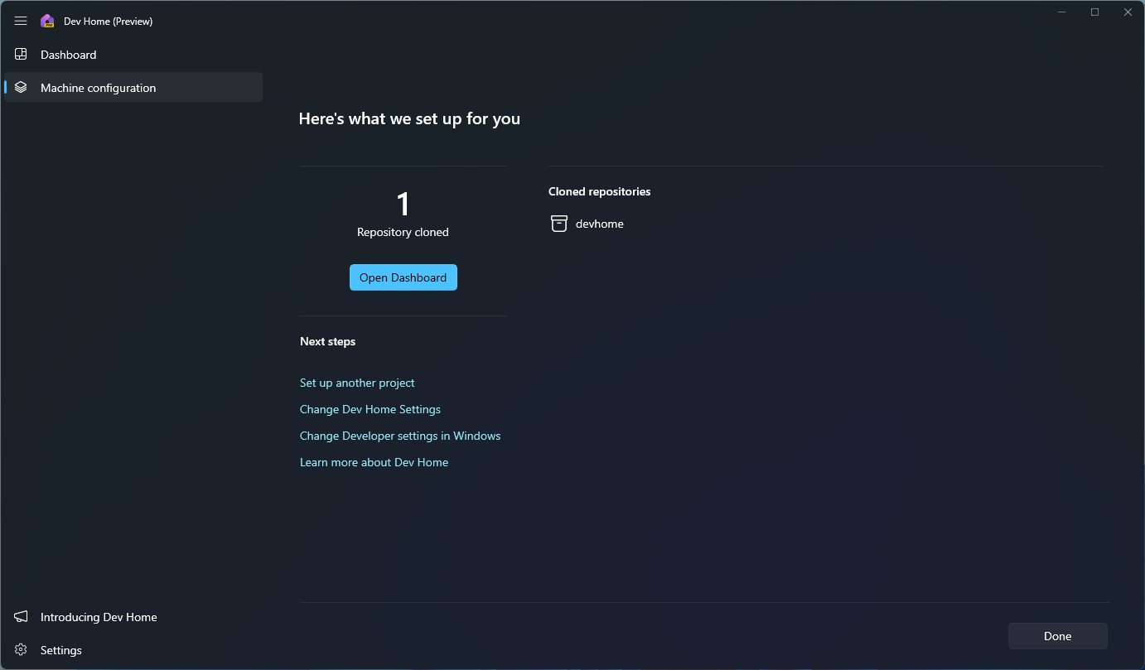
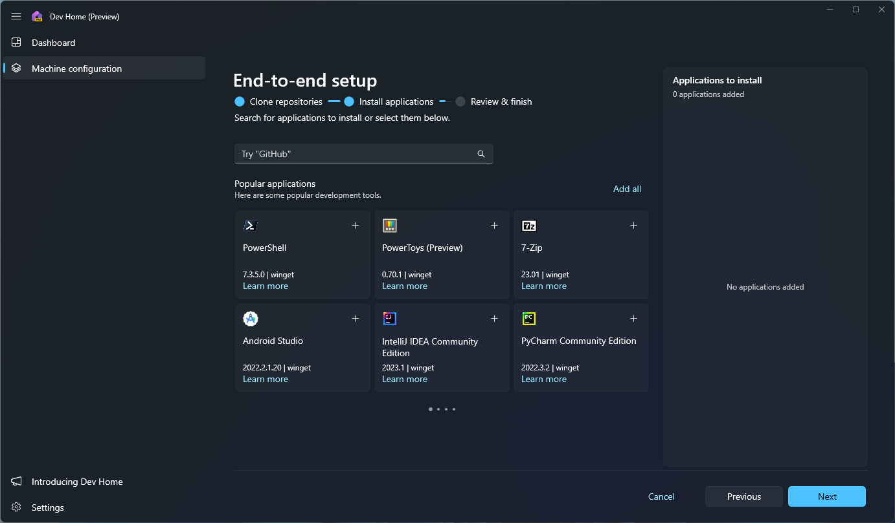
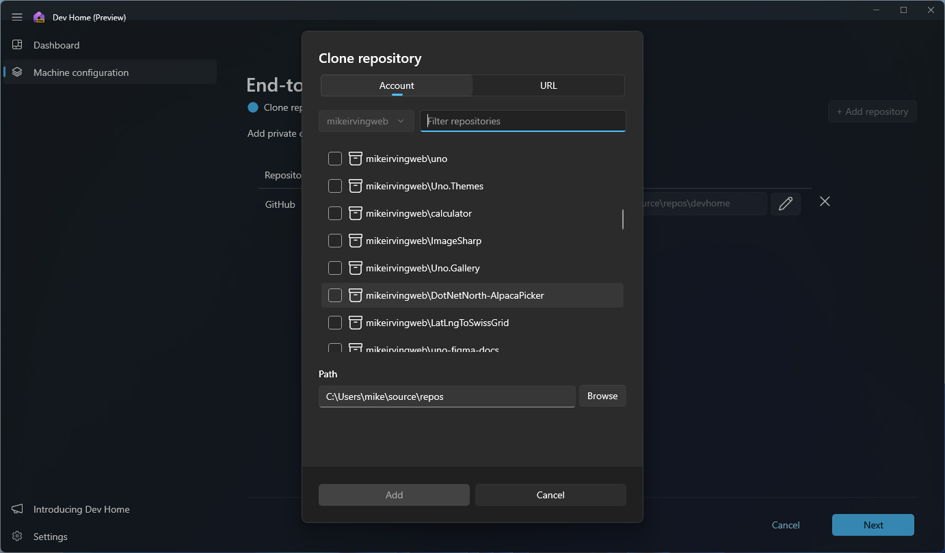
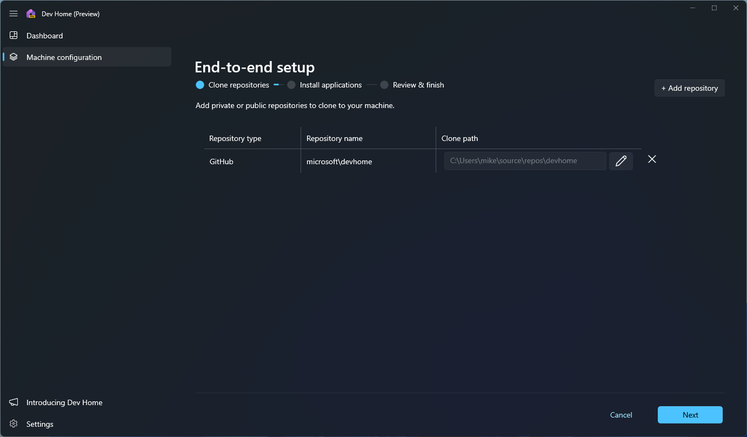
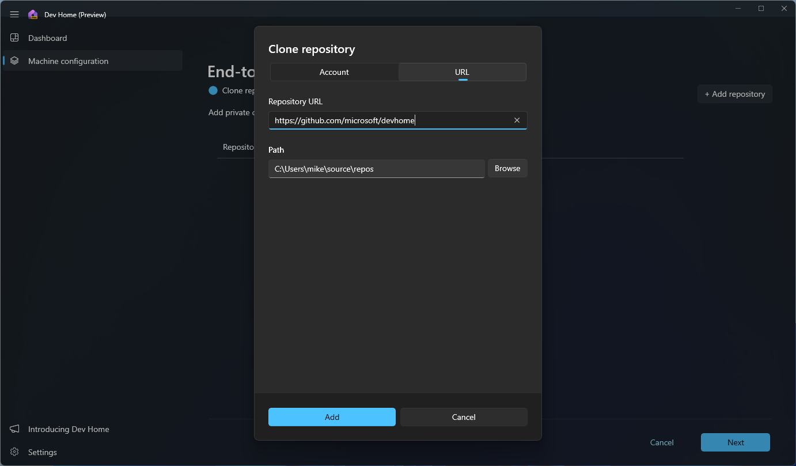
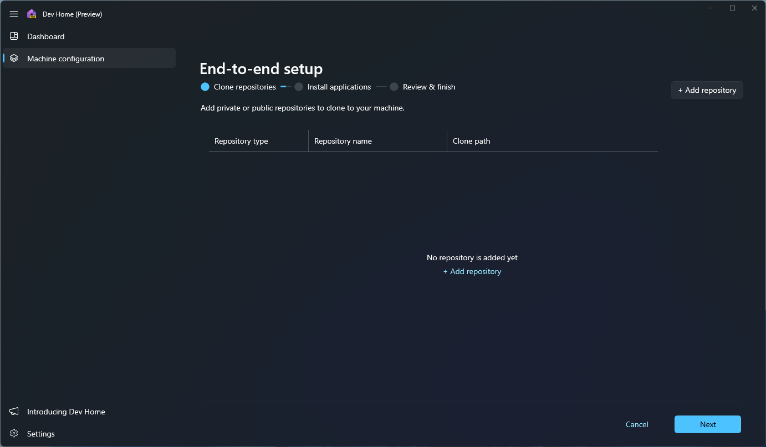
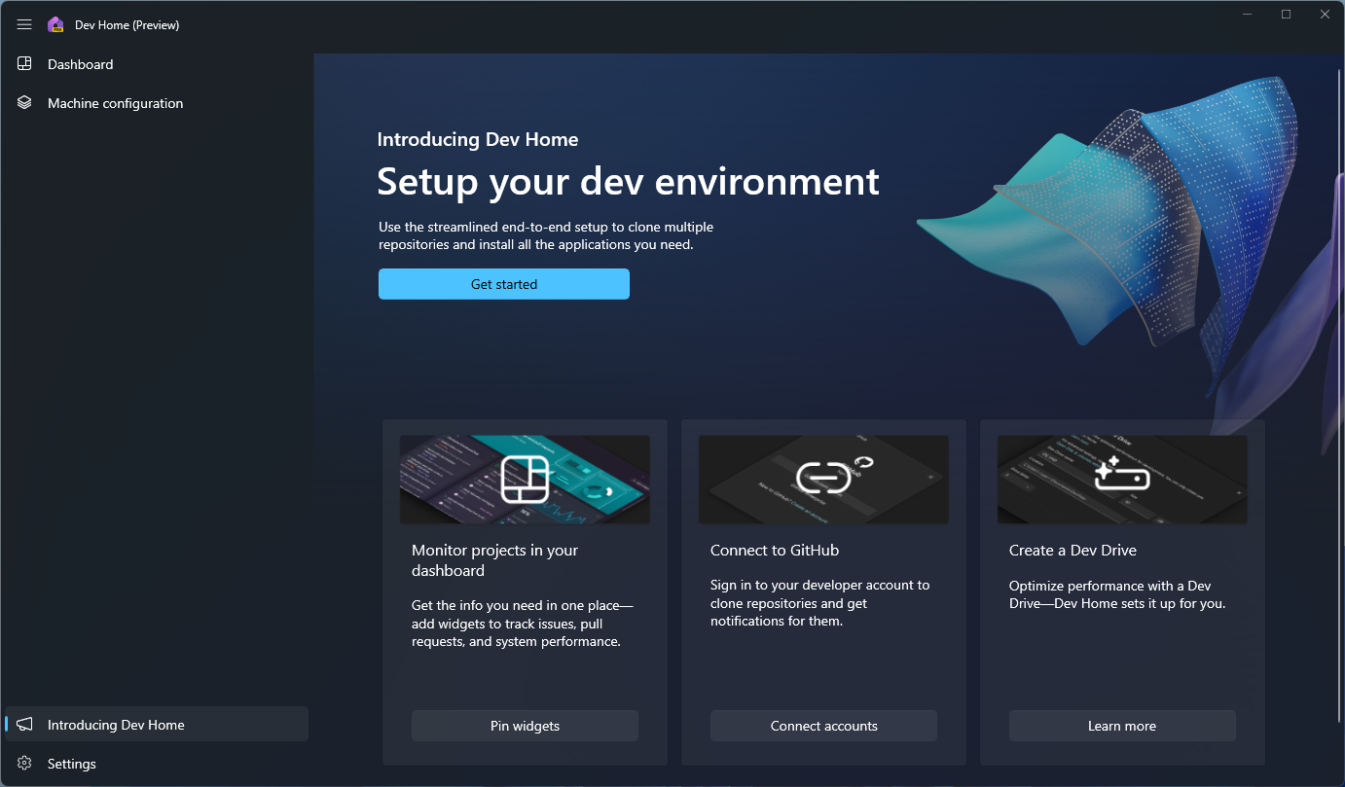
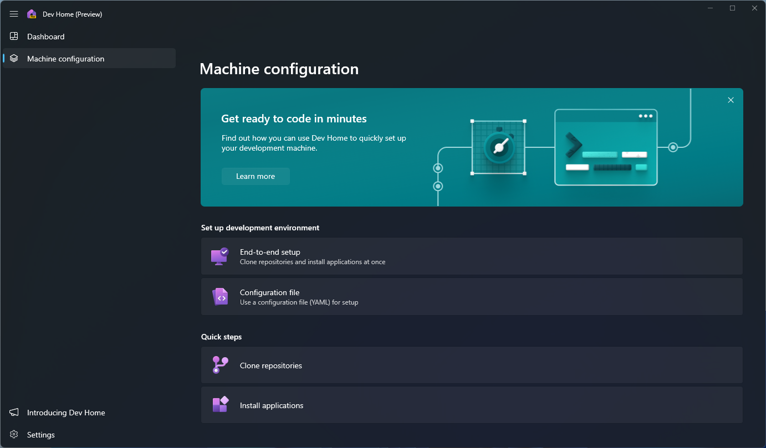
Dev Home

Slide 8
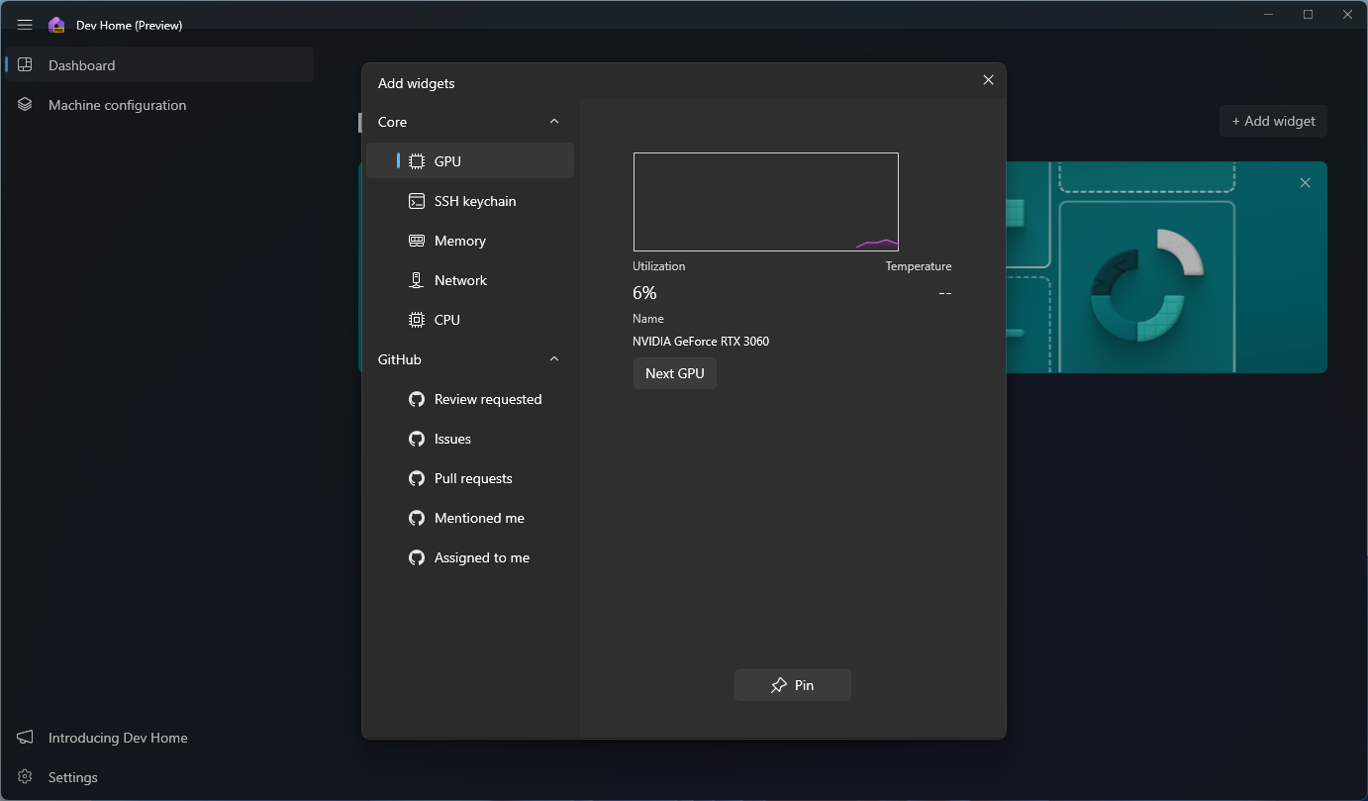
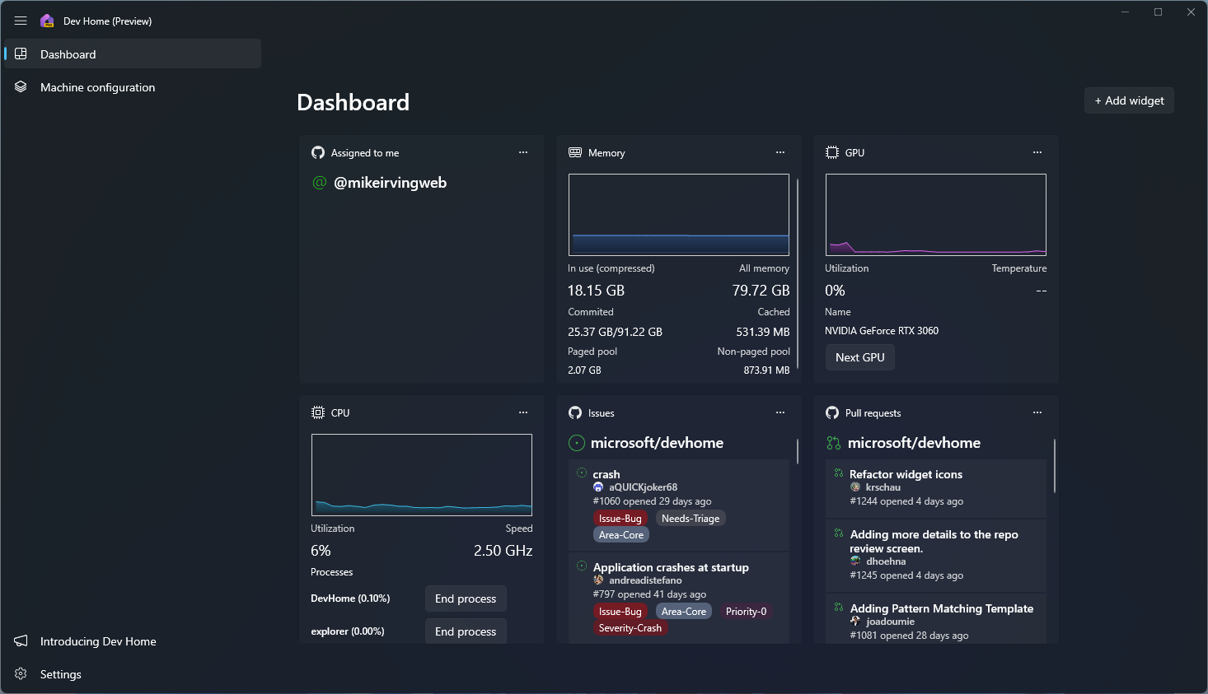
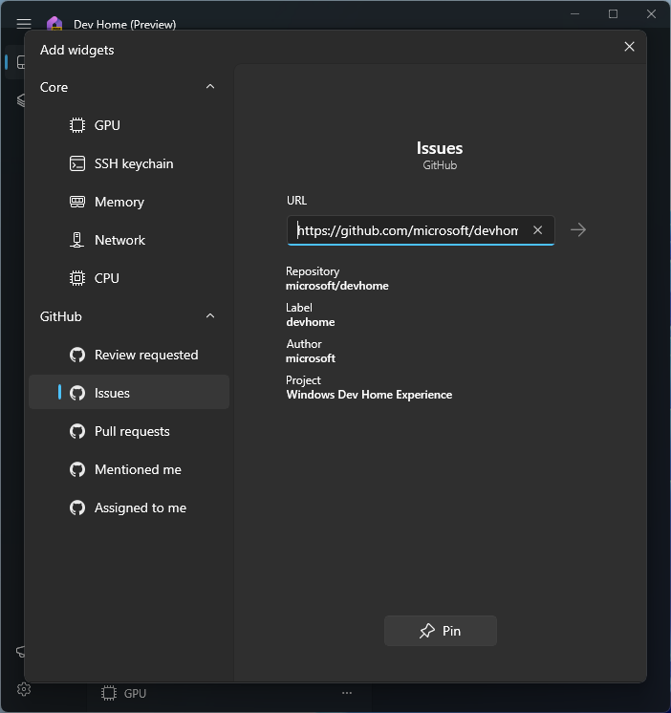
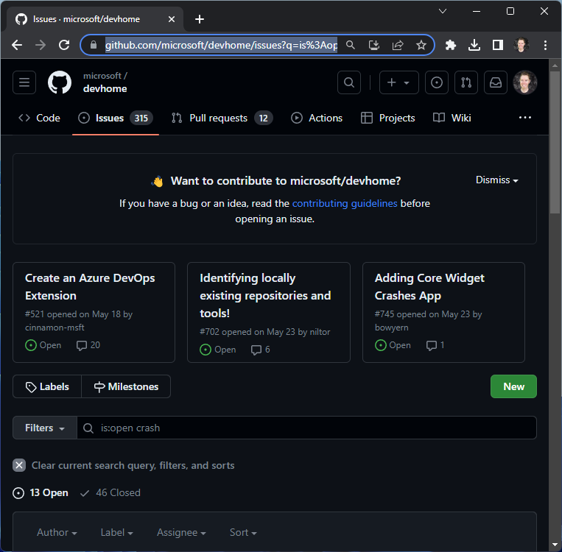
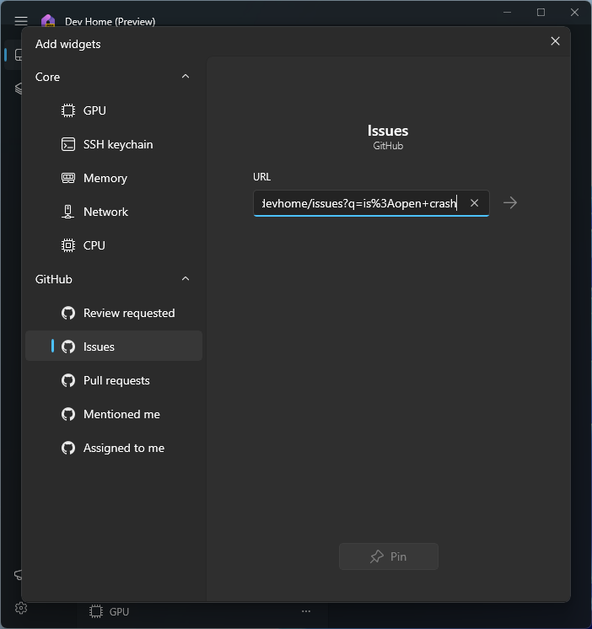
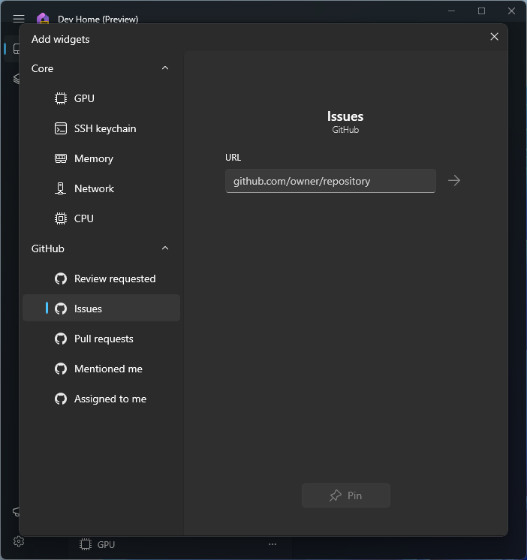
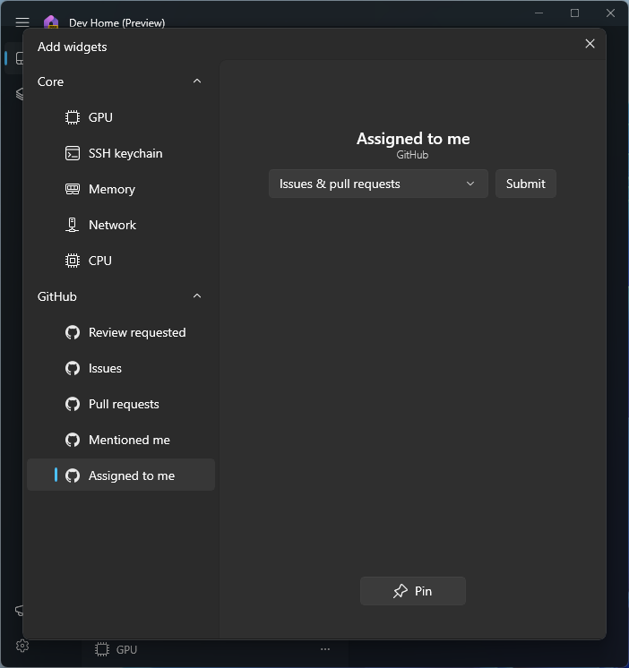
Dev Home

Slide 9
Dev Drive (currently only available via the Windows 11 Insider program)
Dev Drive is a new form of storage volume to improve performance for key developer workloads.
Resilient File System (ReFS) technology
Performance Mode contract with Microsoft Defender Antivirus
~30% Speed Improvement for Dev type workloads
Setup options: 50GB minimum size – except *
Resize an existing volume
Unallocated space on disk
Create new VHD *
The Dev Drive is intended for:
Source code repositories and project files
Package caches
Build output and intermediate files
Dev Drive is not intended to store developer tools, such as:
Visual Studio, MSBuild, .NET SDK, Windows SDK, etc.
These tools should be stored on your main C:\ drive.

Slide 10
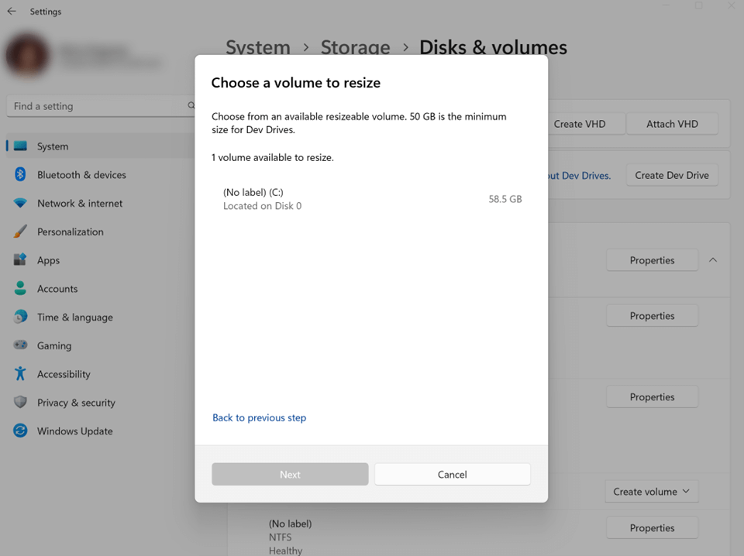
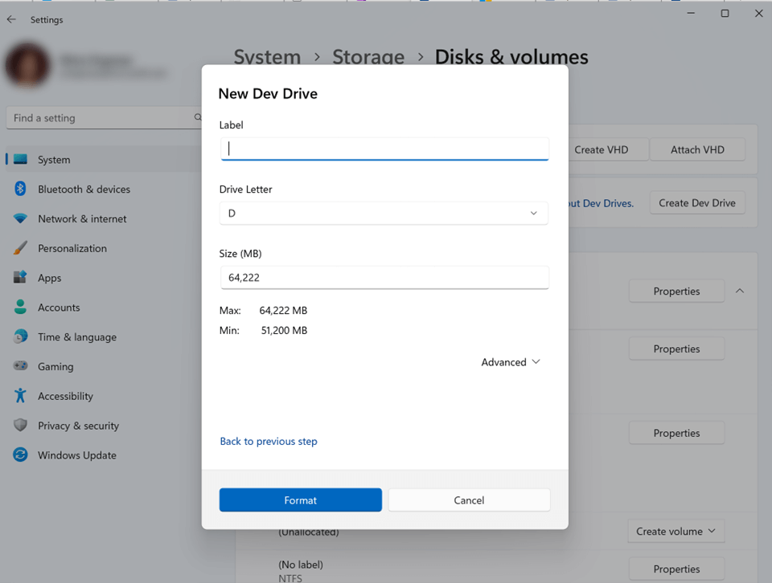
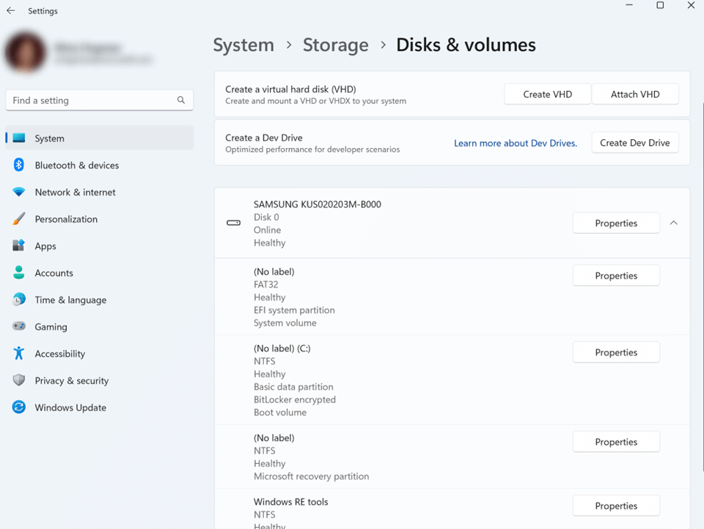
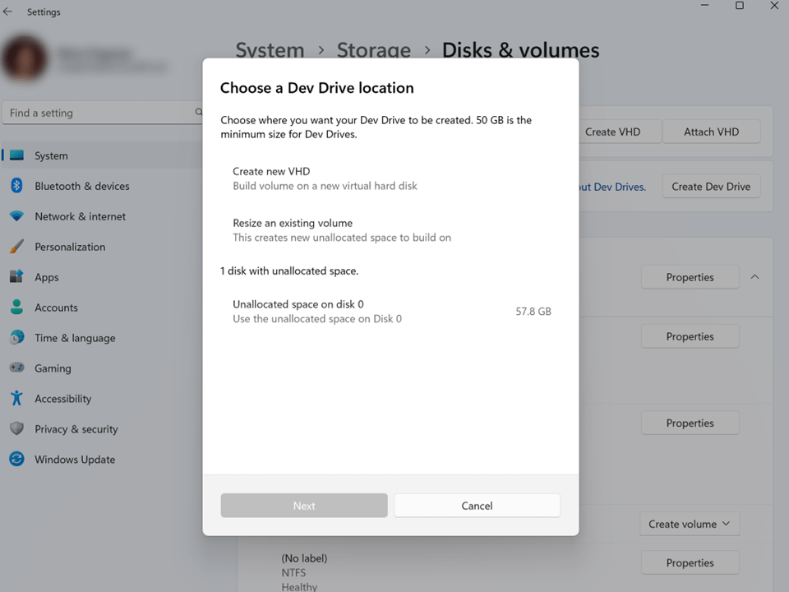
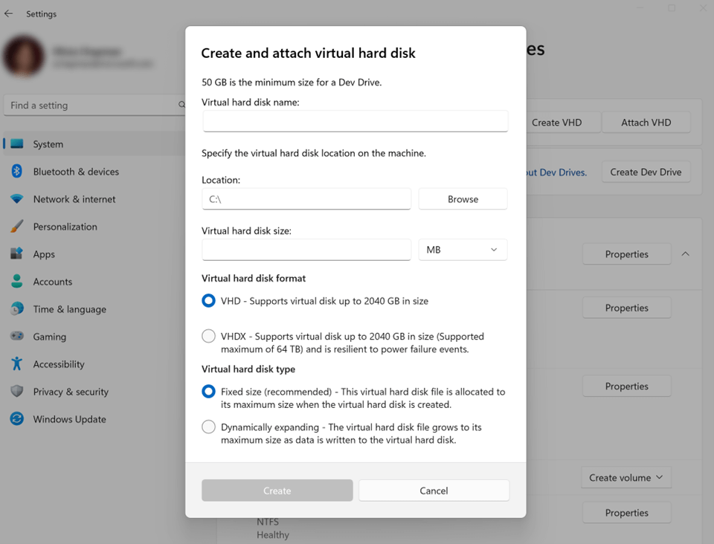
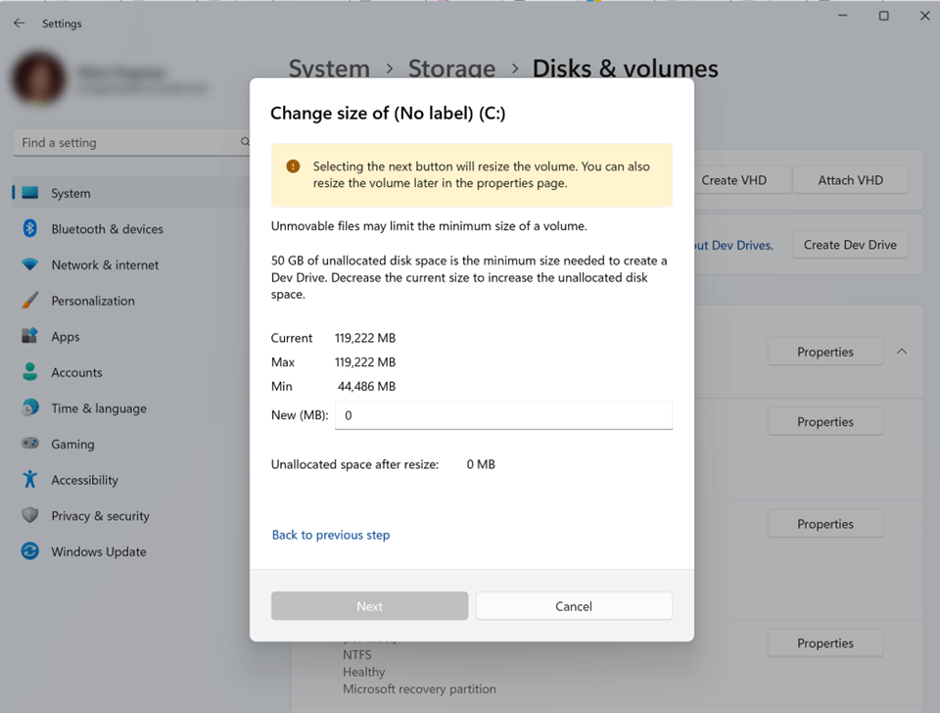
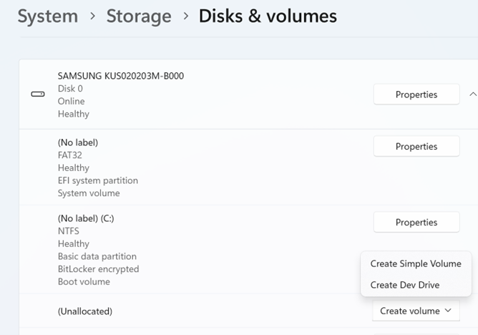
Dev Drive
Currently available in Windows 11 (Public Preview)
System > Storage > Advanced Storage Settings > Disks & volumes

Slide 11
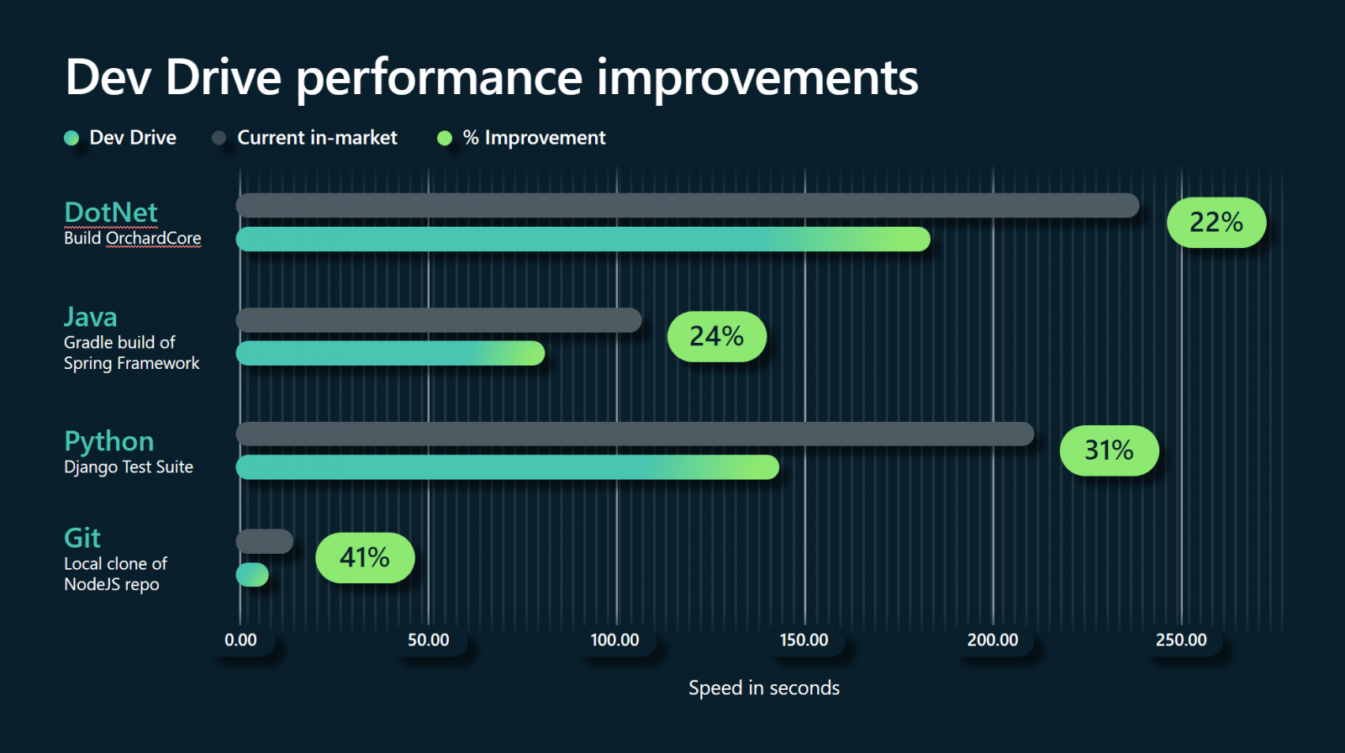
Dev Drive

Slide 13
Windows Subsystem for Android™️

Slide 14
Windows Subsystem for Android™️
Opportunities for developers
Bring your existing Android applications to Windows
Reach millions of potential new users / devices
Add support for Keyboard and Mouse to your apps (recommended)
Amazon Appstore
Access to thousands of apps and games
Port your Google Play apps to Amazon devices, and now Windows devices
The easiest way to install Windows Subsystem for Android™️
Simply install via the Microsoft Store
Debugging Android Apps
Use instead of, or as well as, the Android Emulator, or real devices
Easy to setup

Slide 15
Amazon Appstore
Download from the Microsoft Store

Slide 16
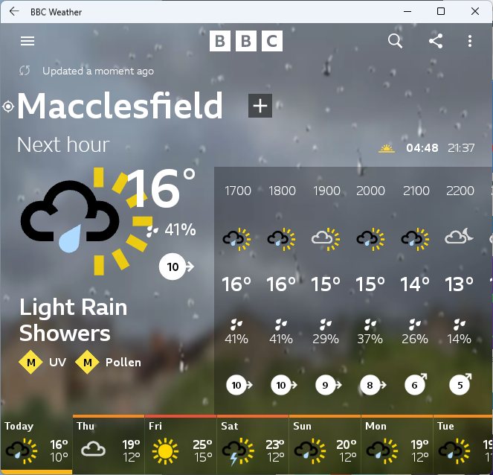
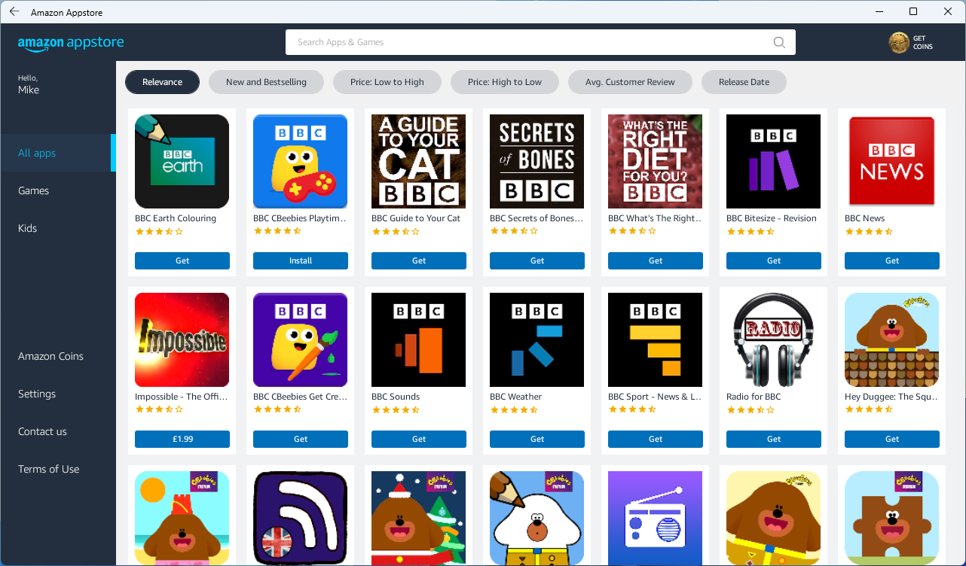
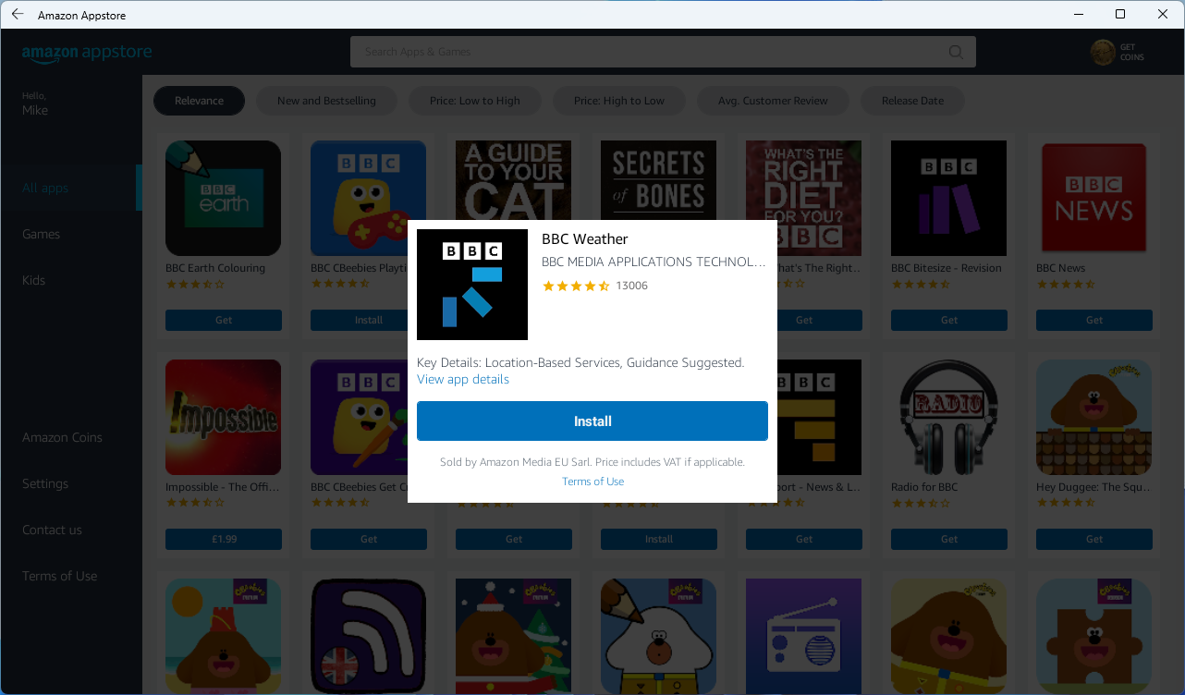
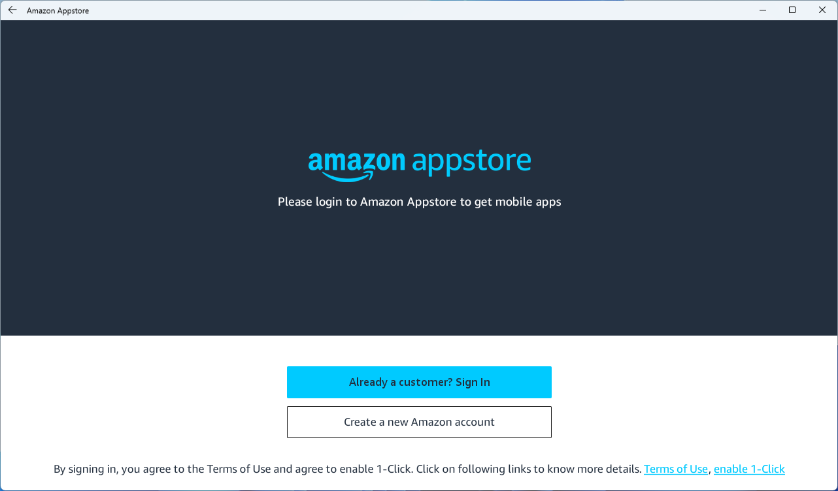
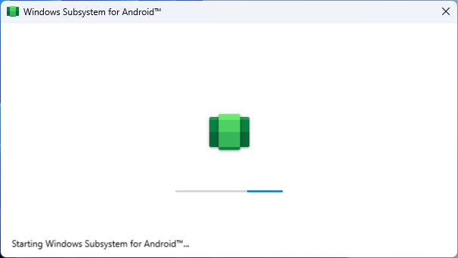
Amazon Appstore
Launching

Slide 17
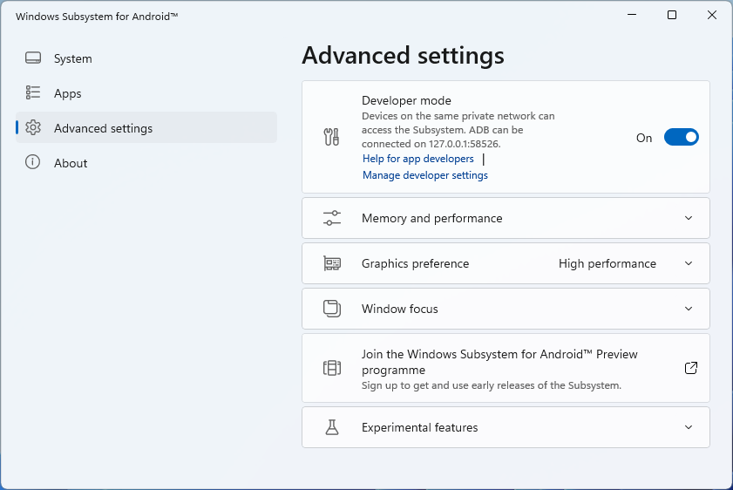
Debugging on WSA
Enable Debugging
Open the Windows Subsystem for Android™️ settings app
Enable Developer mode in Advanced settings
Click Allow on any Windows Defender Prompts

Slide 18
Debugging on WSA
Connect via adb, Allow any security prompts
adb connect 127.0.0.1:58526
Now available as a debugging device in Visual Studio (or Android Studio, or anything else)

Slide 19
Debugging on WSA
Speed comparison: Warm Start
MAUI Example App - slightly modified 🦙
Windows vs Android Emulator vs WSA

Slide 20
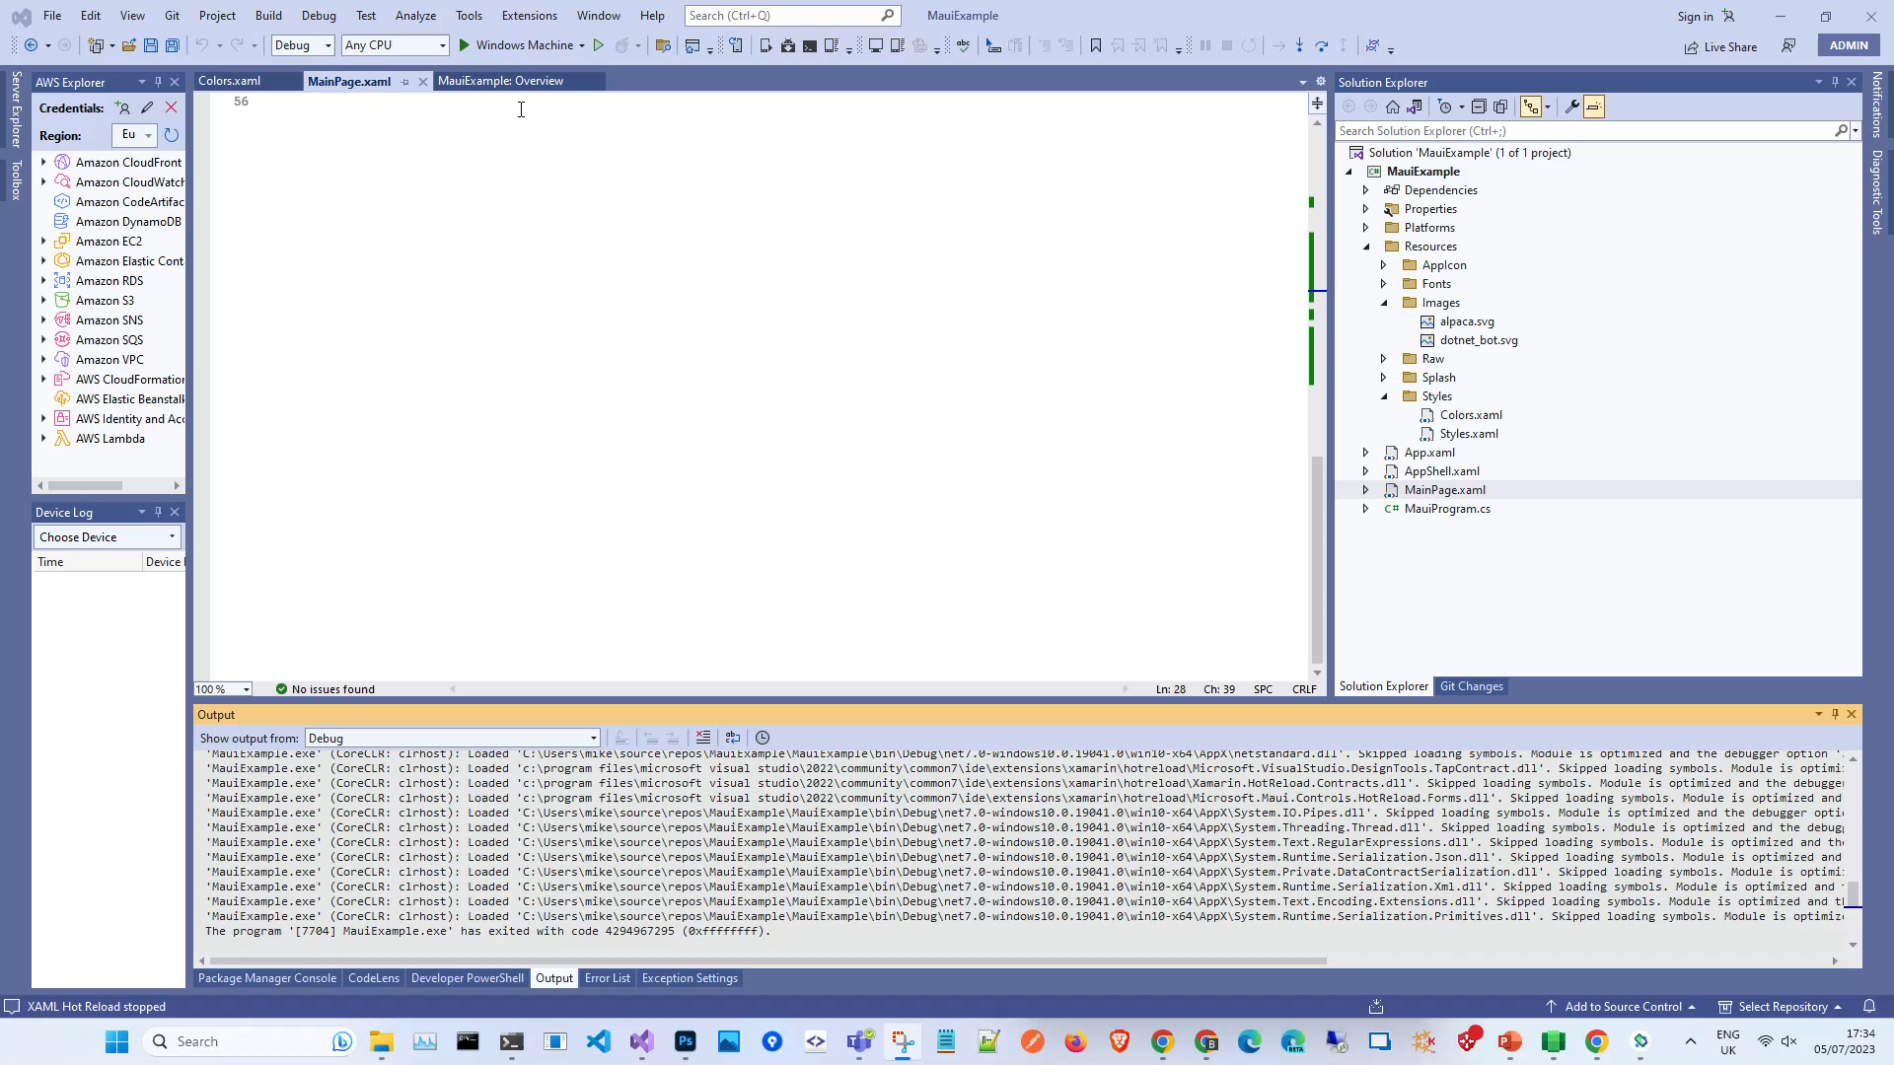

Slide 21
Debugging on WSA
Speed comparison: Cold Start
MAUI Example App - slightly modified 🦙
Android Emulator vs WSA

Slide 22
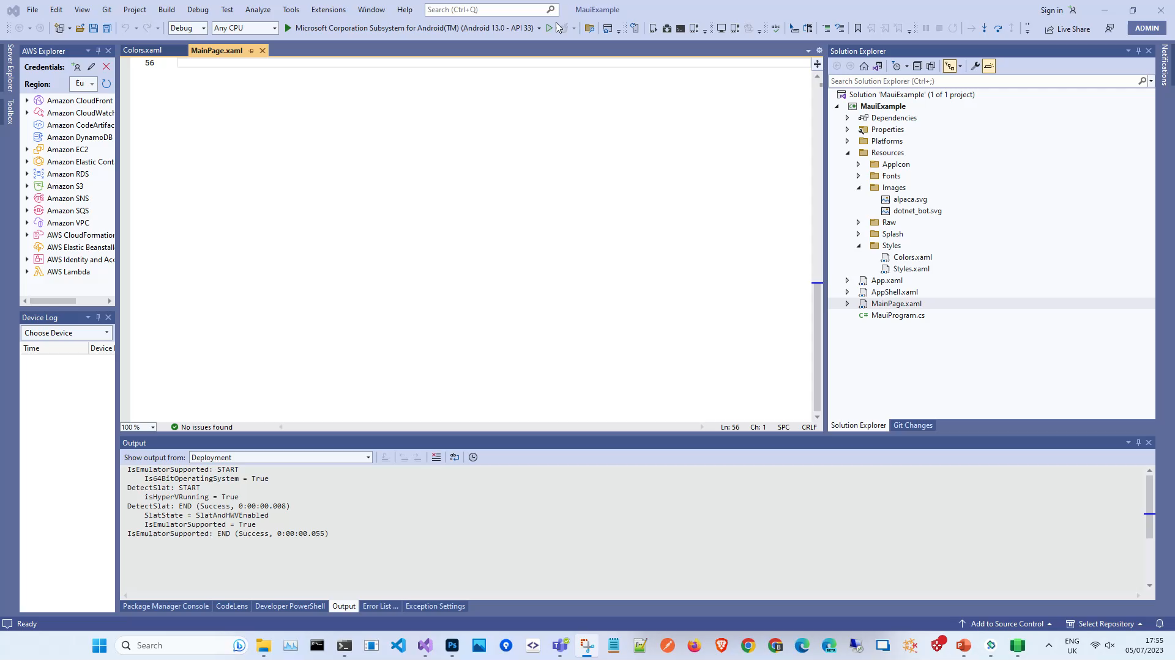

Slide 24

Thank you
Slides available on GitHub at https://github.com/mikeirvingweb/msbuildafterparty23-windows
- All links and video references in the README.md file
For more info, find / contact me at:
Twitter - https://twitter.com/mikeirvingweb
LinkedIn - https://www.linkedin.com/in/mikeirving
GitHub - https://github.com/mikeirvingweb
Stack Overflow - https://stackoverflow.com/users/482901/mike-irving
Website & Blog - https://www.mike-irving.co.uk/

Slide 25
Microsoft Build

